Slide 1
ClusterBots: A Modular Robotic architecture for shared Autonomy and Resources
Swarnabha Roy

Slide 2
Introduction
The importance of coordination among multiple robots has grown significantly over the past few years.
Existing Modular Robotic Systems (MRS) consist of robots that are identical in shape, size, power requirements, and computational resources. Establishing proper coordination among different individual robots will enable more applications but it still needs a lot of refinement.
We can further modify the MRS to make it more modular, giving each of the robots further capabilities in terms of computational performance, energy requirements, and mobility within a smart manufacturing or industrial environment.
The emergence of Cloud robotics provides an efficient alternative for offloading the physical computations from the robot to a cloud computing infrastructure.
In this work, we propose a new modular robotic architecture called ClusterBots where various modular robotic clusters work together by sharing information via a Cloud Server. Our proposed architecture will have a universal communication connector that will allow various modules to connect. The central cloud server can be used for shared autonomy among the modular multi-robot units by sharing resources and sensor information.
This research is mainly targeted towards development of warehouse robotics.

Slide 3
Previous Work
Networked Robotics [1] has been the classical name given to robots connected over a network for functional collaboration.
K. Goldberg et al. [2] were the first to connect a robot to the World Wide Web and control it through a web browser.
‘RoboEarth’ [3] which connected robots worldwide and discussed the key requirements for information sharing among robots, including performance optimization.
Smart Cloud [6] tries to mitigate this problem by using a JavaScript-based framework for application development.
In 2017, a new protocol called RosLink [8] was proposed to overcome the limitations of ROS over a Wide Area Network (WAN).

Slide 4
The current challenges and pathways for research
For many applications, creating a monolithic entity that can address all aspects of a problem can be very expensive and complex; instead, creating multiple, more specialized entities that can share the workload offers the possibility of reducing the complexity of the individual entities.
"distributed intelligent systems may require more communication to coordinate all the entities in the system as they must act without complete knowledge of the other entities” intents. Finally, systems of multiple entities will typically experience increased uncertainty about the state of the system as a whole.“
All this research so far has been solely based on a platform having some dependencies on language.
Our work expands on the current state of the art by developing a platform-independent system.
We will use a ROS master as a cloud server to deploy code in any language and communicate with any robot connected to the server network.

Slide 5
Project Plan
Initial Framework
ROS Cloud Server setup
Create Robot LAN
Inter module Sensor Fusion
Connected intelligence among sub modules
Test data throughput
Shared autonomy
Fallback behaviour when connection is lost
Dynamic computation offloading
Setup Modular WAN
Security
Local Sensor Fusion
Develop a universal communication protocol across sensors
Online and offline data storage handling
Test Fault tolerance
Due to the limited time of the class, the Initial Framework is done along with developing a universal communication protocol across various other modules.
Work for Online and offline data storage handling is still under progress.

Slide 6

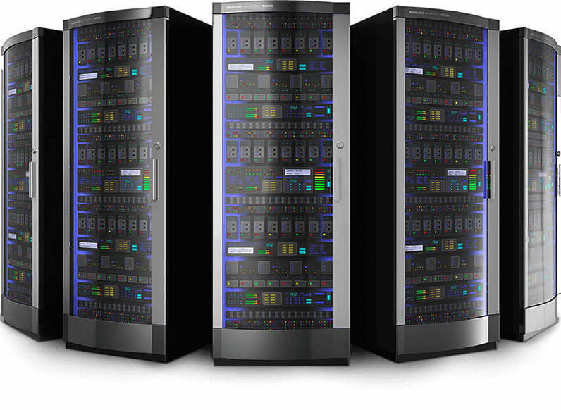
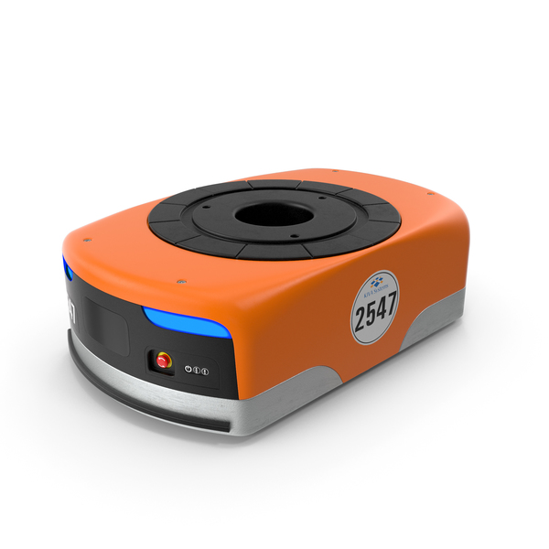
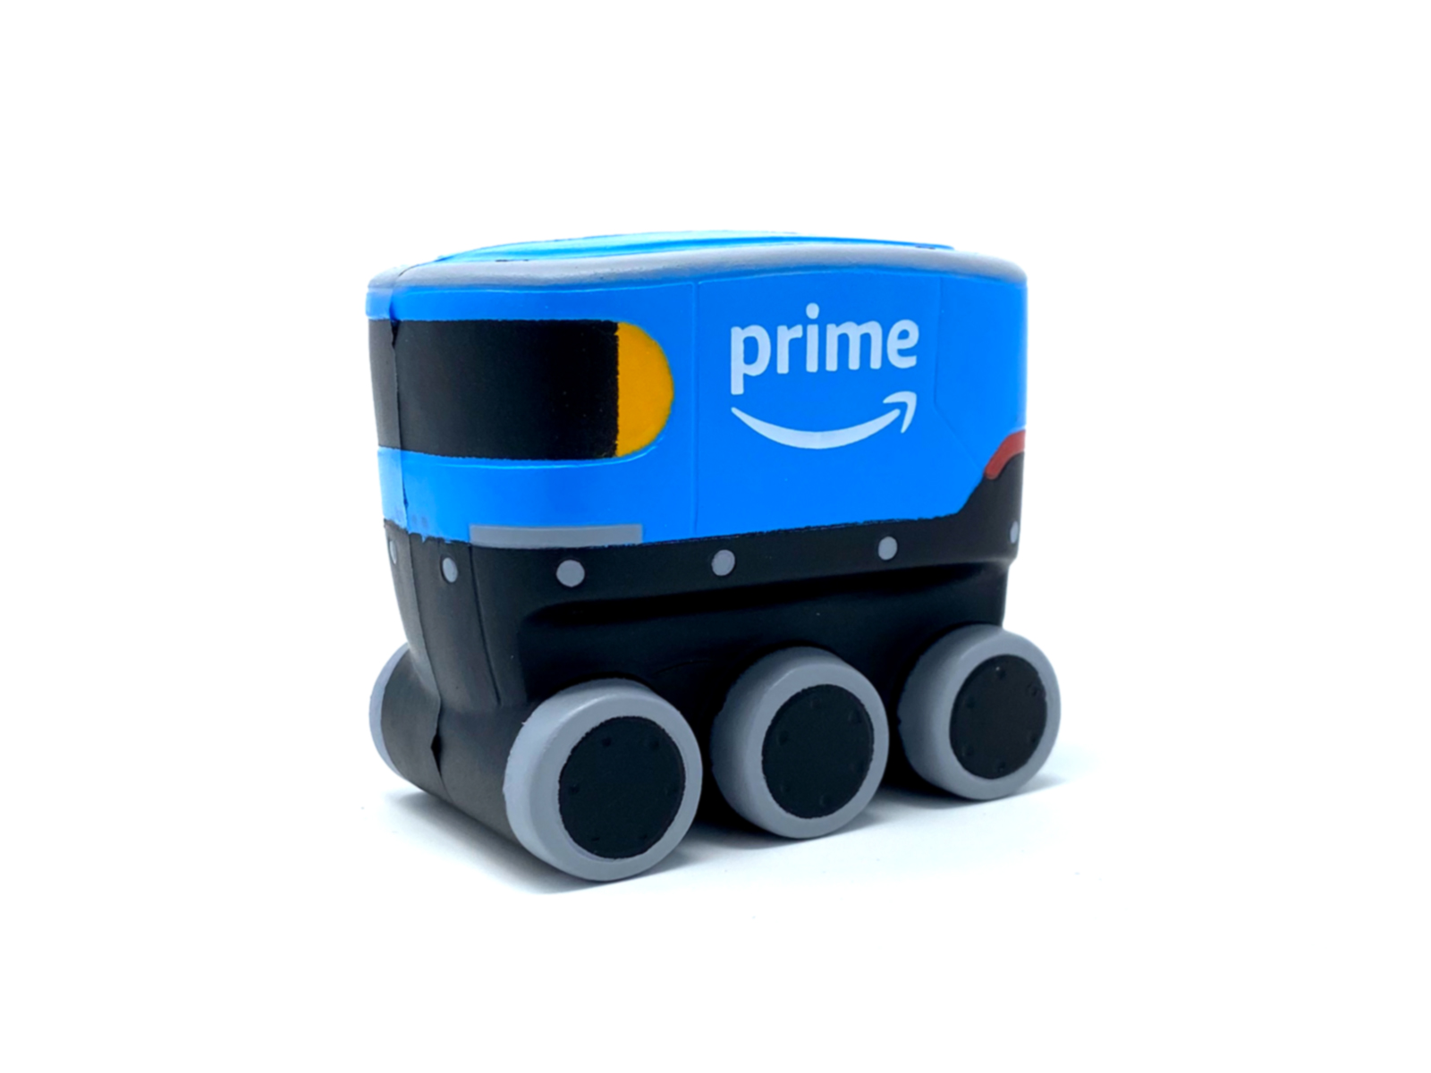
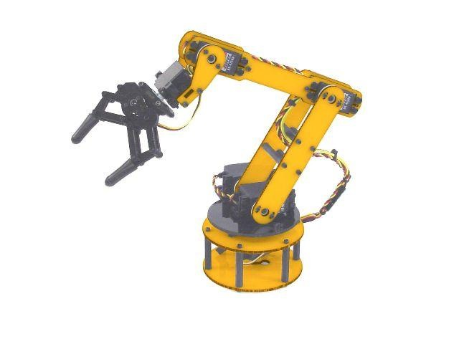
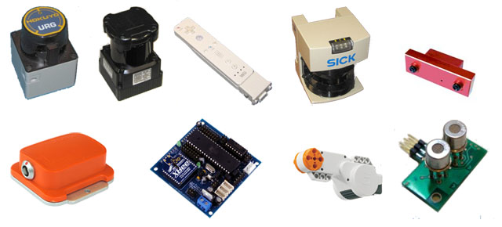
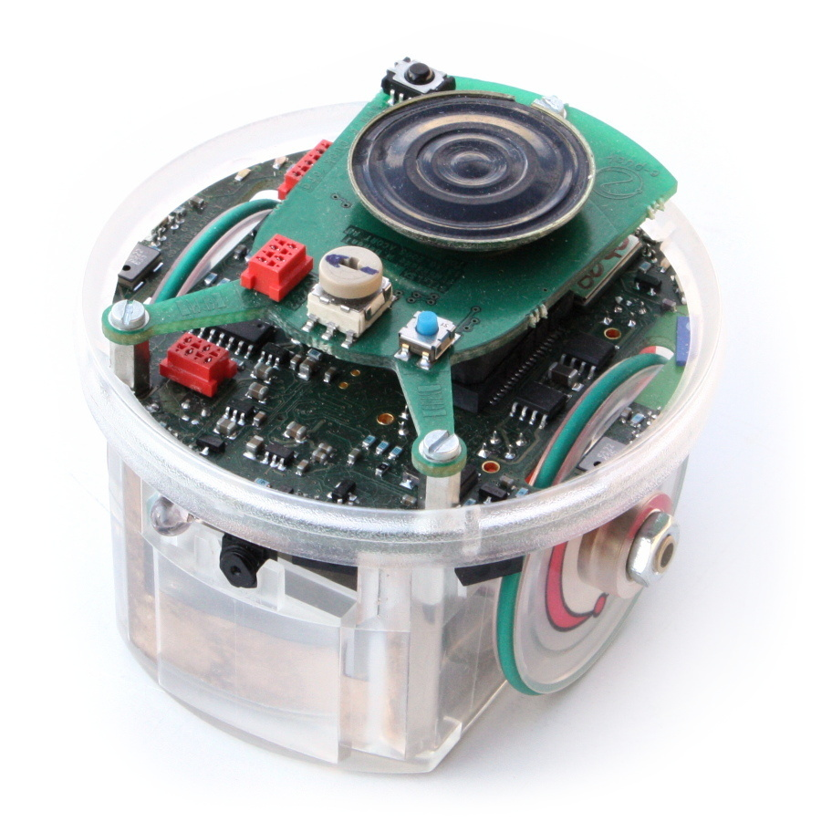
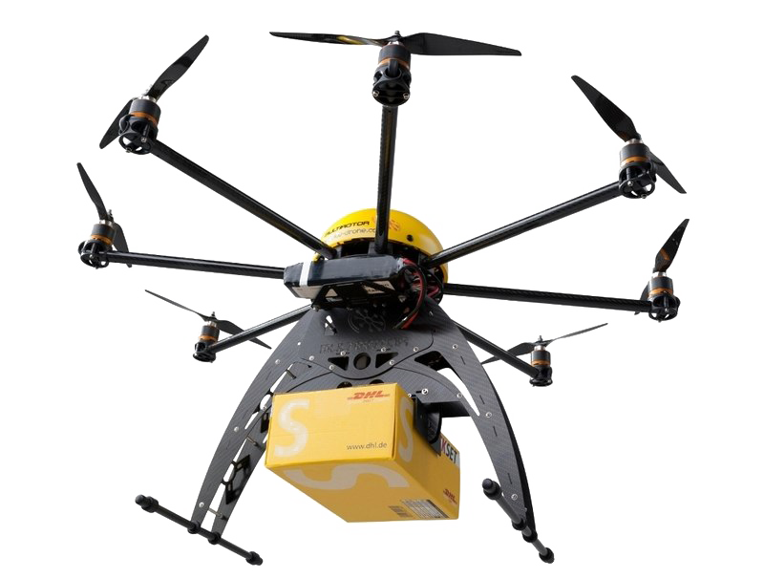
The proposed architecture
Communication via ROS Topics and sockets
Communication via ROS Topics and sockets
Cluster Node 1: Running Client ROS
Cluster Node 3: Running client ROS
AWS Cloud Server running the ROS master
Cluster Node 2: Running client ROS

Slide 7
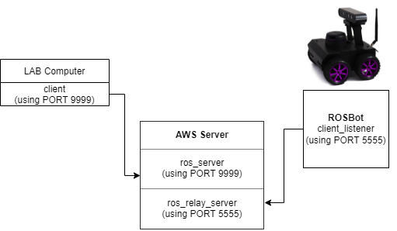
Approach taken and architecture so far
We have chosen an Amazon EC2 instance as the cloud server. The Cloud server is running on Ubuntu 16 build with ROS Melodic.
For the purpose of this class, we have chosen to show a three-way communication, transferring messages between two different ROS machines/clusters on two completely different networks.
One of the machine is our lab computer which is running on Ubuntu 18.04 with ROS Melodic and the other is a ROSBot 2.0 Pro running on ROS Melodic.
Experiment rough sketch

Slide 8

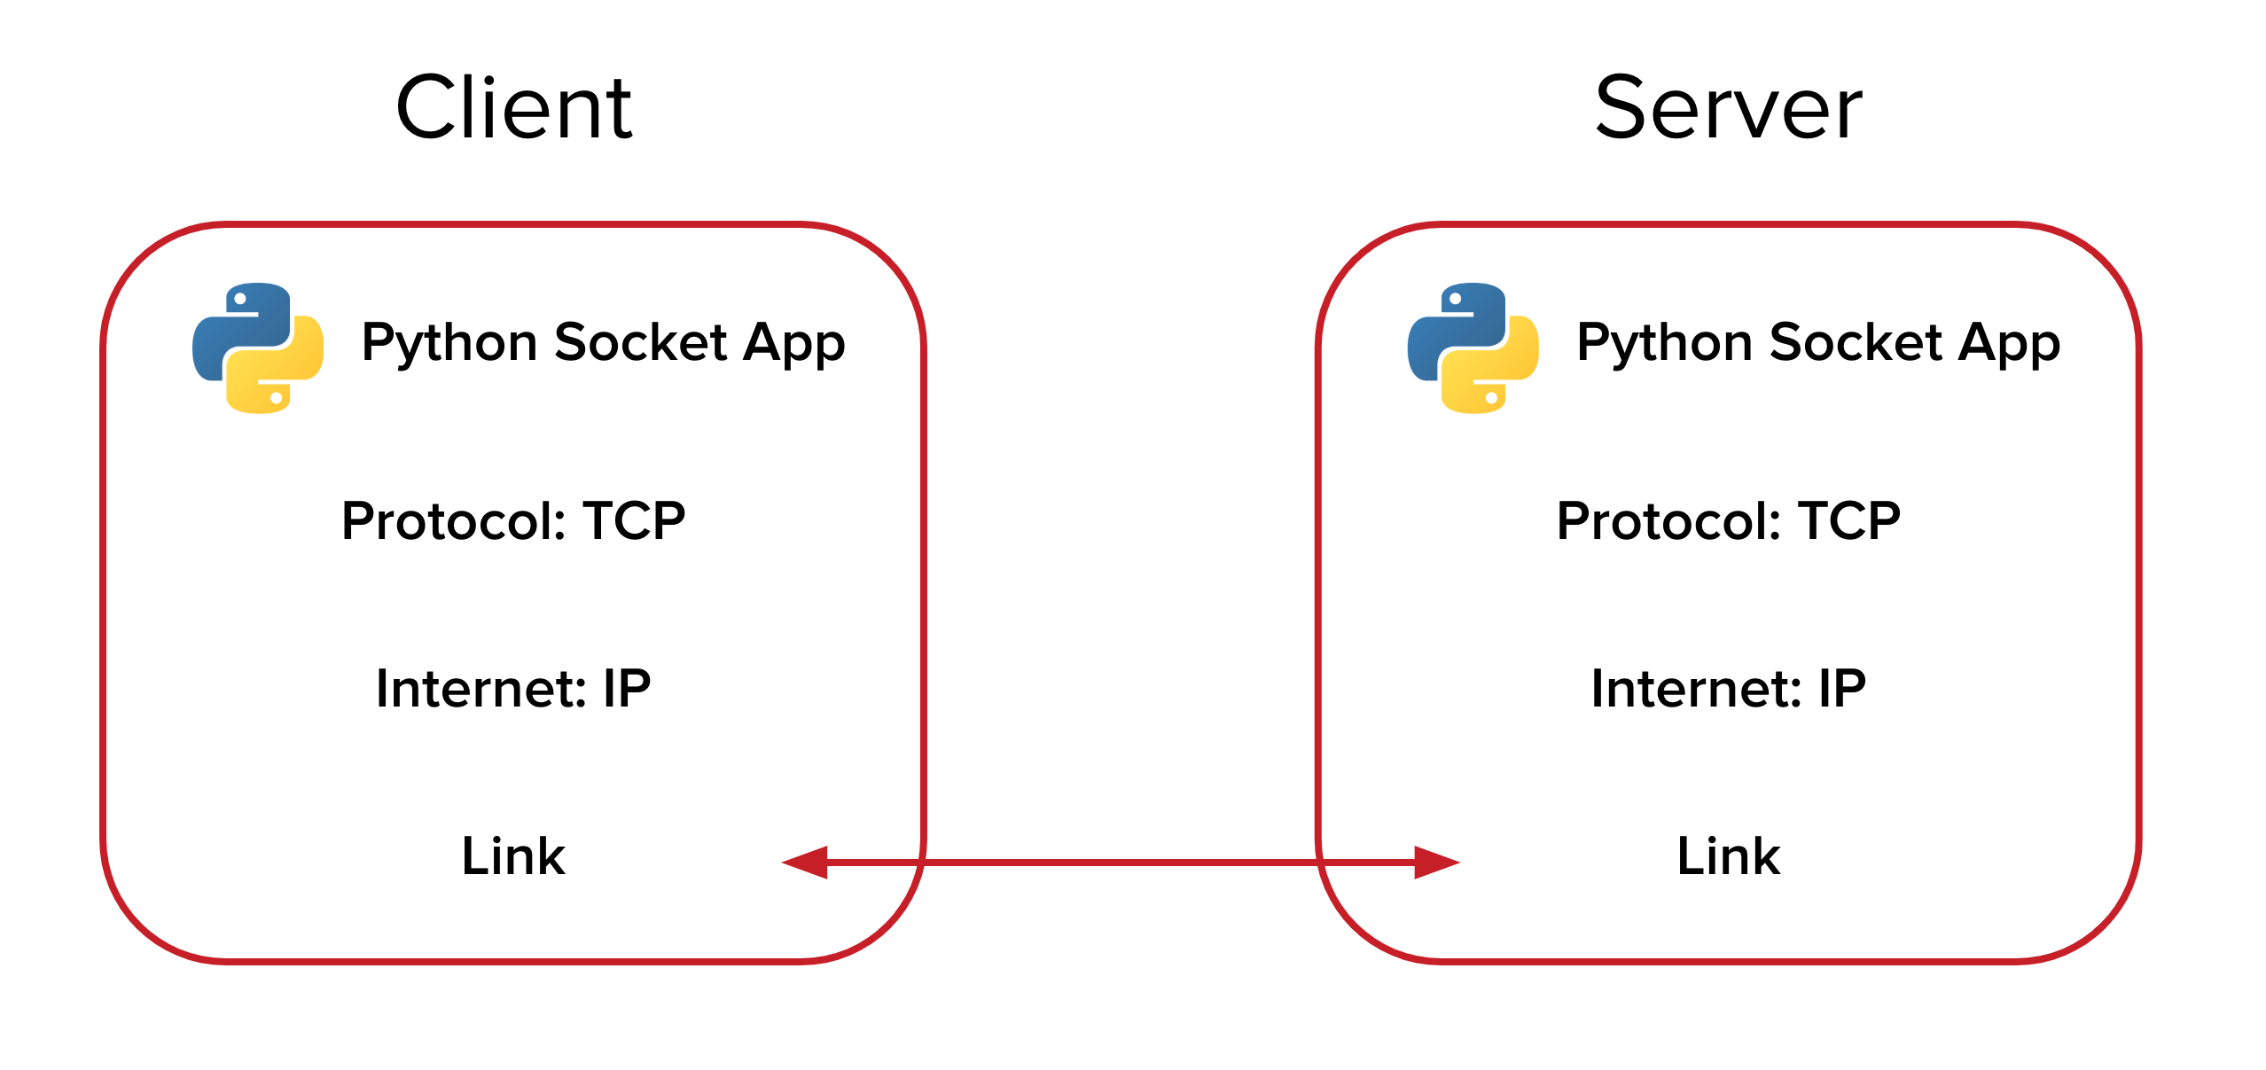
Approach taken and architecture so far
ROS has a built in feature that allows us to define a single MASTER in a network and all the devices can communicate with the ROS MASTER via rostopics.
But here, all the devices and clusters need to be in the same network. Besides the library is very finicky and unreliable due to information loses.
We developed our own library on Python >=3.5 that uses ROS and TCP/IP socket protocols and data communication pipelines for rostopics.
All the clusters have their own roscore running and they can connect to the central server i.e. the AWS Cloud server using socket PORTS.
Services used

Slide 9
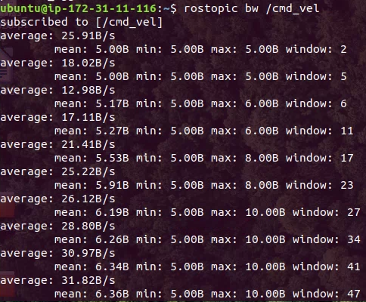
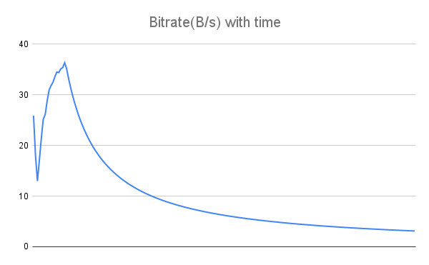
Results
The ROSBot kinematics takes in information via rostopic /cmd_vel.
We ran the client listener code on the ROSBot which subscribes to PORT 5555 on AWS where we published the /cmd_vel messages.
The lab computer ran the client code that send the motion commands via another rostopic /turtle1/cmd_vel to PORT 9999.
The AWS server acts as a data hub for all the information.
The data bandwidth and bit rate is significant enough to transfer a low resolution image within seconds as shown in figure. The bitrate spiked as we started to send data and gradually settled to zero on halt.
Bandwidth and Bitrate for the /cmd_ vel rostopic published

Slide 10
Future Work
In the future, we plan on exploring using IPv6 and create three different data socket pipelines based on the bandwidth requirement and urgency of the data: Ultra-fast, medium and high-definition.
Ultra-fast pipeline will be the fastest with low bandwidth and high data rate; medium with slightly slower data rate and wider bandwidth and so on.
We will use reinforcement learning based approach to categorize the data.

Slide 11
References
Haidegger, Tamás, Péter Galambos, and Imre J. Rudas. "Robotics 4.0–Are we there yet?." 2019 IEEE 23rd International Conference on Intelligent Engineering Systems (INES). IEEE, 2019.
K. Goldberg, M. Mascha, S. Gentner, N. Rothenberg, C. Sutter, and J. Wiegley, “Desktop teleoperation via the world wide web,” in Proceedings of 1995 IEEE International Conference on Robotics and Automation, vol. 1, May 1995, pp. 654–659 vol.1
Waibel, Markus, Michael Beetz, Javier Civera, Raffaello d'Andrea, Jos Elfring, Dorian Galvez-Lopez, Kai Häussermann et al. "Roboearth." IEEE Robotics & Automation Magazine 18, no. 2 (2011): 69-82.
J. Kuffner, "What's Next: Cloud-Enabled Humanoids?" in 10th IEEE-RAS International Conference on Humanoid Robots (Humanoids 2010) Workshop, 2010.
Fierro, Rafael, Aveek Das, John Spletzer, Joel Esposito, Vijay Kumar, James P. Ostrowski, George Pappas et al. "A framework and architecture for multi-robot coordination." The International Journal of Robotics Research 21, no. 10-11 (2002): 977-995.
Penmetcha, Manoj, Shyam Sundar Kannan, and Byung-Cheol Min. "Smart Cloud: Scalable Cloud Robotic Architecture for Web-powered Multi-Robot Applications." arXiv preprint arXiv:1912.02927 (2019).
Mohanarajah, Gajamohan, Dominique Hunziker, Raffaello D'Andrea, and Markus Waibel. "Rapyuta: A cloud robotics platform." IEEE Transactions on Automation Science and Engineering 12, no. 2 (2014): 481-493.
Koubaa, Anis, Maram Alajlan, and Basit Qureshi. "ROSLink: bridging ROS with the internet-of-things for cloud robotics." Robot Operating System (ROS). Springer, Cham, 2017. 265-283.
Houxiang Zhang, Juan Gonzalez-Gomez, Zhizhu Me, Sheng Cheng and Jianwei Zhang, "Development of a low-cost flexible modular robot GZ-I," 2008 IEEE/ASME International Conference on Advanced Intelligent Mechatronics, 2008, pp. 223-228, doi: 10.1109/AIM.2008.4601663.
Simoens, Pieter, Mauro Dragone, and Alessandro Saffiotti. "The Internet of Robotic Things: A review of the concept, added value, and applications." International Journal of Advanced Robotic Systems 15, no. 1 (2018): 1729881418759424.
Geyer, Charles J. "Practical Markov chain monte carlo." Statistical science (1992): 473-483.
Zykov, Victor, Andrew Chan, and Hod Lipson. "Molecubes: An open-source modular robotics kit." IROS-2007 Self-Reconfigurable Robotics Workshop. 2007.
Yan, Zhi, Nicolas Jouandeau, and Arab Ali Cherif. "A survey and analysis of multi-robot coordination." International Journal of Advanced Robotic Systems 10.12 (2013): 399.
Parker, Lynne E. "Distributed Intelligence: Overview of the Field and its Application in Multi-Robot Systems." AAAI fall symposium: regarding the intelligence in distributed intelligent systems. 2007.

Slide 12
THANK YOU

